Slide 1
Array [2-Dimensional]
Course Code: CSC 2106
Course Title: Data Structure (Theory)
Dept. of Computer Science
Faculty of Science and Technology
Lecturer No: | 2.1 | Week No: | 2 | Semester:
Lecturer: | Name & email

Slide 2
Lecture Outline
Array [2-Dimensional]
Definition, Structure & Declaration
Initialization
Access
Memory Access
Books
References

Slide 3
Array [2-Dimensional]
Definition, Structure & Declaration
Two-dimensional arrays can be described as "arrays of arrays". For example, a 2D array can be imagined as a Two-dimensional table made of elements of same uniform data type.
minu represents a Two-dimensional array of 3 per 5 elements of type int. The way to declare this array in C++ would be: int minu [3][5];
The way to reference the 2nd element vertically and 4th horizontally or the (2 × 4) 8th element in an expression would be: minu [1][3];
Generally, for two-dimensional array, 1st dimension is considered as row and the 2nd dimension is considered as column. Here, we have 3 rows and 5 columns.
minu | { |  | 0 | 1 | 2 | 3 | 4
 |  | 0 | minu[0][0] | minu[0][1] | minu[0][2] | minu[0][3] | minu[0][4]
 |  | 1 | minu[1][0] | minu[1][1] | minu[1][2] | minu[1][3] | minu[1][4]
 |  | 2 | minu[2][0] | minu[2][1] | minu[2][2] | minu[2][3] | minu[2][4]

Slide 4
Initialization
Assigning values at the time of declaring a two-dimensional array can be any one of the following ways:
int minu[3][5] = {1,2,3,4,5,2,4,6,8,10,3,6,9,12,15};
int minu[3][5] = {{1,2,3,4,5},{2,4,6,8,10},{3,6,9,12,15}};
int minu[3][5] = {
{1,2,3,4,5},
{2,4,6,8,10},
{3,6,9,12,15}
};
The internal braces are unnecessary but helps to distinguish the rows from the columns.
Take care to include the semicolon at the end of the curly brace which closes the assignment.
If there are not enough elements in the curly braces to account for every single element in an array, the remaining elements will be filled out with garbage/zeros.
Static and global variables are always guaranteed to be initialized to zero anyway, whereas auto or local variables are guaranteed to be garbage.

Slide 5
Access
Nested loop is used to take input and give output.
The input is taken in row (1st dimension) major. i.e. all the values of row 0 is scanned first, then the values of row 1, and values of row 2. For each row, value at column 0 is scanned first, then the value at column 1, and value at column 2.
In output, array a is used in row major. But array b is used in column (2nd dimension) major. i.e. all the values of column 0 is added first, then the values of column 1, and values of column 2. For each column, value at row 0 is added first, then the value at row 1, and value at row 2.
Consider the following example (the dark area at the end consists the input and the output of this program; the yellow-colored text represents input given by the user and black colored text represents output):
1 2 3 4 5 6 7 8 9 10 11 | // input & output of a 2D array void main (void) { int i, j, a[3][3], b[3][3]={1,3,5,7,9,2,4,6,8}; for(i=0;i<3;i++) for(j=0;j<3;j++) cin>>a[i][j]; for(i=0;i<3;i++) for(j=0;j<3;j++) cout<<a[i][j] + b[j][i]; }
 | 2 4 6 8 1 3 5 7 9 ? ? ? ? ? ? ? ? ?

Slide 6
Access
Nested loop is used to take input and give output.
The input is taken in row (1st dimension) major. i.e. all the values of row 0 is scanned first, then the values of row 1, and values of row 2. For each row, value at column 0 is scanned first, then the value at column 1, and value at column 2.
In output, array a is used in row major. But array b is used in column (2nd dimension) major. i.e. all the values of column 0 is added first, then the values of column 1, and values of column 2. For each column, value at row 0 is added first, then the value at row 1, and value at row 2.
Consider the following example (the dark area at the end consists the input and the output of this program; the yellow colored text represents input given by the user and black colored text represents output):
1 2 3 4 5 6 7 8 9 10 11 | // input & output of a 2D array void main (void) { int i, j, a[3][3], b[3][3]={1,3,5,7,9,2,4,6,8}; for(i=0;i<3;i++) for(j=0;j<3;j++) cin>>a[i][j]; for(i=0;i<3;i++) for(j=0;j<3;j++) cout<<a[i][j] + b[j][i]; }
 | 2 4 6 8 1 3 5 7 9 3 11 10 11 10 9 10 9 17

Slide 7
Memory Access
Two-dimensional arrays are just an abstraction for programmers, since we can obtain the same results with a simple array just by putting a factor between its indices: int minu [3][5]; is equivalent to (3 * 5 = 15); int minu [15];
2D Array
1D array
int minu [3][5], H=3, W=5, n, m, i=0;
void main (void){
for (n=0; n<H; n++)
for (m=0; m<W; m++)
minu [n][m]= ++i;
}
int minu [3 * 5], H=3, W=5, n, m, i=0;
void main (void){
for (n=0; n<H; n++)
for (m=0; m<W; m++)
minu [ W * n + m ] = ++i;
}
 | 0 | 1 | 2 | 3 | 4
0 | 1 | 2 | 3 | 4 | 5
1 | 6 | 7 | 8 | 9 | 10
2 | 11 | 12 | 13 | 14 | 15
As memory is flat, in both codes the values are actually stored sequentially in the memory (just like the 1D array). The access for the two-dimensional array in that case is just as the indexing of the array,
[(Total_column) * (row_index) + (column_index)]
 | 0 | 1 | 2 | 3 | 4 | 5 | 6 | 7 | 8 | 9 | 10 | 11 | 12 | 13 | 14
 | 1 | 2 | 3 | 4 | 5 | 6 | 7 | 8 | 9 | 10 | 11 | 12 | 13 | 14 | 15
Height
Width
n
m
Width * n + m
0
2
2
2
1
0
6
9
3
5
0
3
7
1
8
14
4
13
1
4
3
11
12
5
10

Slide 8
Memory Access
Memory of each element of an array can be accessed using the & operator.
&mimo[2] gives the memory location of the 3rd element of the array mimo.
If the element is more than a byte, it gives the starting byte of the element.
Let us consider the starting address of int mimo[5] is 567.
&mimo[2] will give us the memory location 575.
mimo[2] will give us 4 bytes (int) of information starting from 575 to 579.
The name of an array always refer to the starting location of the array. i.e. the first element of the array. So, mimo = &mimo[0].
 | 0 |  |  |  | 1 |  |  |  | 2 |  |  |  | 3 |  |  |  | 4
mimo
567 |  | 569 |  | 571 |  | 573 |  | 575 |  | 577 |  | 579 |  | 581 |  | 583 |  | 585 |  | 587
 | 568 |  | 570 |  | 572 |  | 574 |  | 576 |  | 578 |  | 580 |  | 582 |  | 584 |  | 586

Slide 9
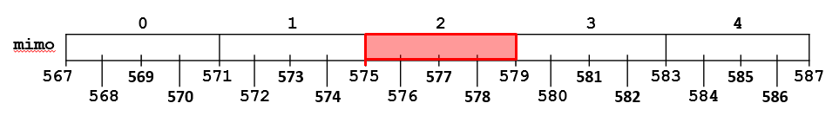
Memory Access
&mimo[2] will give us the memory location 575.
mimo[2] will give us 4 bytes (int) of information starting from 575 to 579.
The name of an array always refer to the starting location of the array. i.e. the first element of the array. So, mimo = &mimo[0].
&array[index]=start_location_array + index * size_of_data
&mimo[ 2 ] = mimo (or &mimo[0]) + 2 * sizeof(int)
&mimo[ 2 ] = 567 + 2 * 4 = 575

Slide 10
Memory Access
567 |  |  | 571 |  |  |  | 575 |  |  |  | 579
 | 0 |  |  |  | 1 |  |  |  | 2
0
1
 |  |  |  |  | ←583 |  |  |  | ←587
579→
2
3
Consider a 2D array mimo[R][C] each element addressed by &mimo[i][j], where R=total element in 1st dimension, C=total element in 2nd dimension, 0≤ i < R, 0 ≤ j < C.
Let int mimo[4][3]; Here, mimo or &mimo[0][0] gives us the starting memory location 567.
mimo[1][1] will give us 4 bytes (int) of information starting from 583 to 587.
 | 0 |  |  |  | 1 |  |  |  | 2 |  |  |  | 3 |  |  |  | 4
mimo
567 |  | 569 |  | 571 |  | 573 |  | 575 |  | 577 |  | 579 |  | 581 |  | 583 |  | 585 |  | 587
 | 568 |  | 570 |  | 572 |  | 574 |  | 576 |  | 578 |  | 580 |  | 582 |  | 584 |  | 586
&array[i][j]=start_location + (i * c + j) * size_of_data
&mimo[1][1] = mimo + (1 * 3 + 1) * sizeof(int)
&mimo[1][1] = 567 + (3 + 1) * 4 = 583

Slide 11
Memory Access
There is a general way to access the memory location of a 2 dimensional array.
For an array int mimo[R][C]; and 0≤i<R; 0≤j<C.
mimo[i] = &mimo[i][0] represents the starting address of i^{th} row.
mimo[i] skips i number of rows each with C number of elements from the start_location of the array.
So, mimo[i] = start_location + (i * C elements), where C elements are counted in bytes based on the size_of_data, here int.
So, mimo[i] = start_location + (i * (C * size_of_data)).
So, mimo[i] = mimo(or &mimo[0][0]) + (i * (C *sizeof(int))).
A 2D array is also referred as an array of arrays. i.e. an array of which each element is another array.

Slide 12
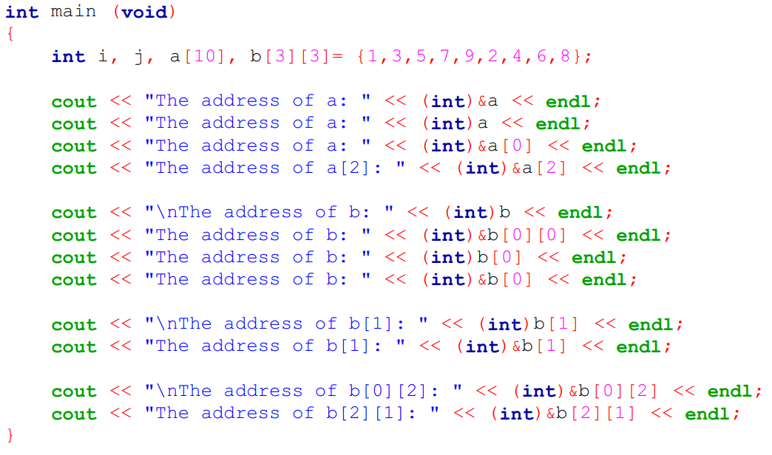
Memory Address

Slide 13
Books
“Schaum's Outline of Data Structures with C++”. By John R. Hubbard
“Data Structures and Program Design”, Robert L. Kruse, 3rd Edition, 1996.
“Data structures, algorithms and performance”, D. Wood, Addison-Wesley, 1993
“Advanced Data Structures”, Peter Brass, Cambridge University Press, 2008
“Data Structures and Algorithm Analysis”, Edition 3.2 (C++ Version), Clifford A. Shaffer, Virginia Tech, Blacksburg, VA 24061 January 2, 2012
“C++ Data Structures”, Nell Dale and David Teague, Jones and Bartlett Publishers, 2001.
“Data Structures and Algorithms with Object-Oriented Design Patterns in C++”, Bruno R. Preiss,

Slide 14
References
https://en.wikipedia.org/wiki/Array_data_structure
https://www.programiz.com/cpp-programming/strings
https://cal-linux.com/tutorials/strings.html
http://www.cplusplus.com/reference/cstring/
http://www.cplusplus.com/reference/string/string/
https://cal-linux.com/tutorials/strings.html

